Slide 1
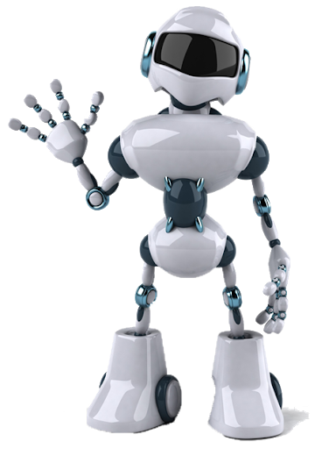
Hello Everyone !

Slide 2

Autonomous Mobile Robotics Course
Final Presentation
By: Walid Shaker
4 thruster-Boat drive control using Gazebo and ROS2

Slide 3
Content
Boat Dynamic Model
Feedback Linearization with Proportional-Derivative (PD) Control
odeint / RK4
Recover Thrust Forces and Rudder Angles
ROS2/ Gazebo

Slide 4
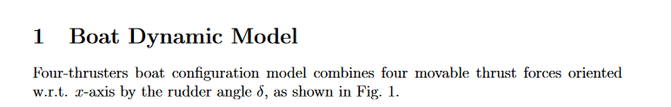
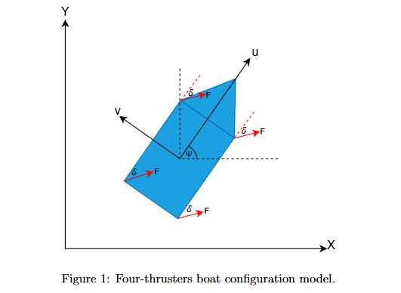
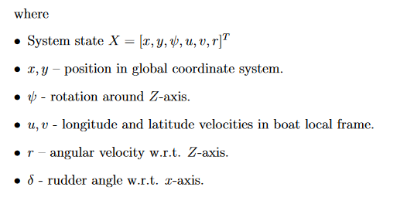
Boat Dynamic Model

Slide 5
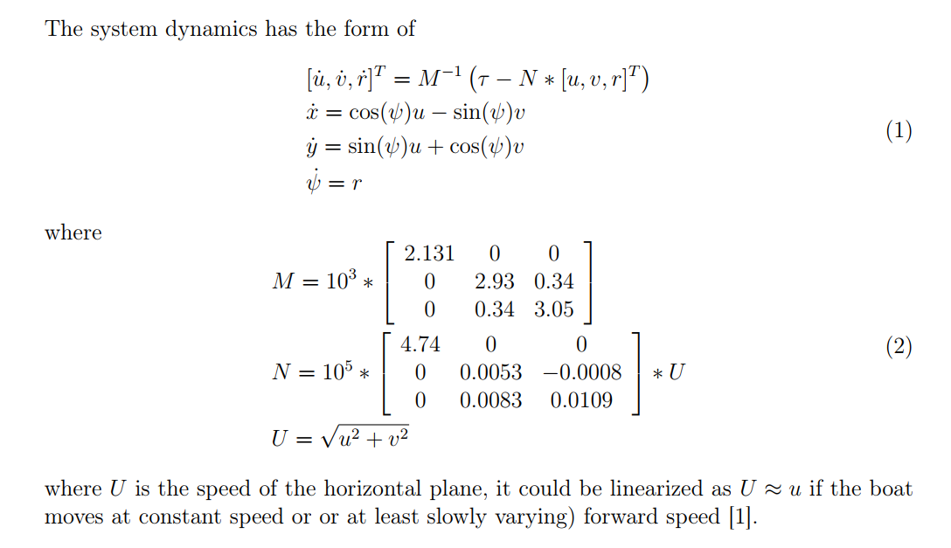
Boat Dynamic Model

Slide 6
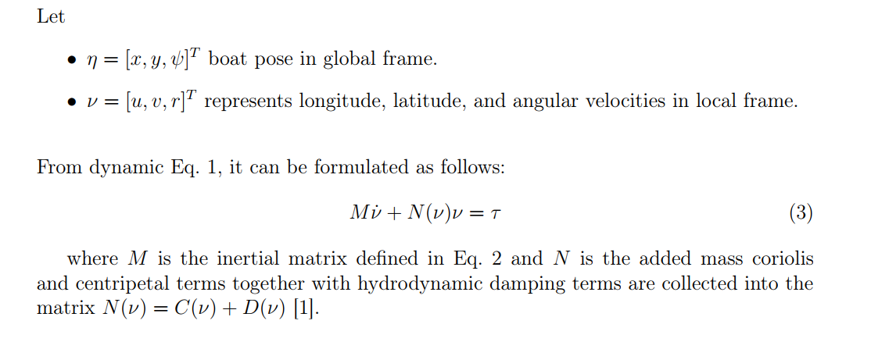
Boat Dynamic Model

Slide 7
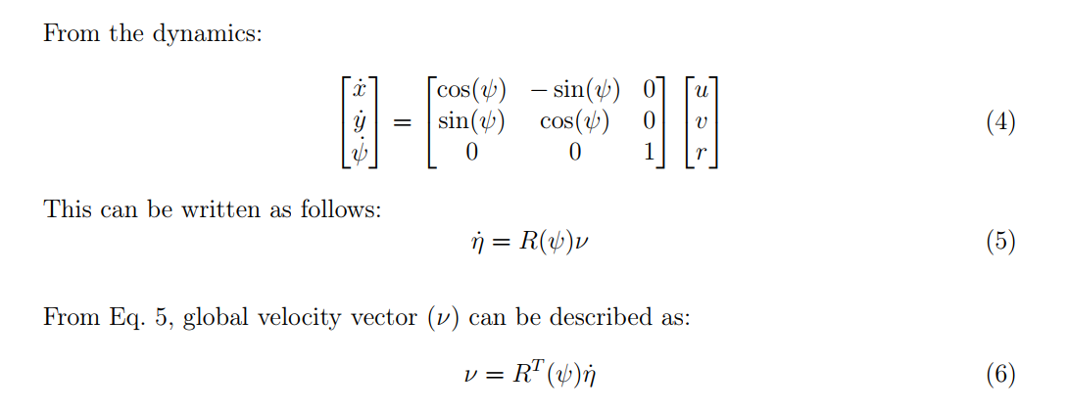
Boat Dynamic Model

Slide 8
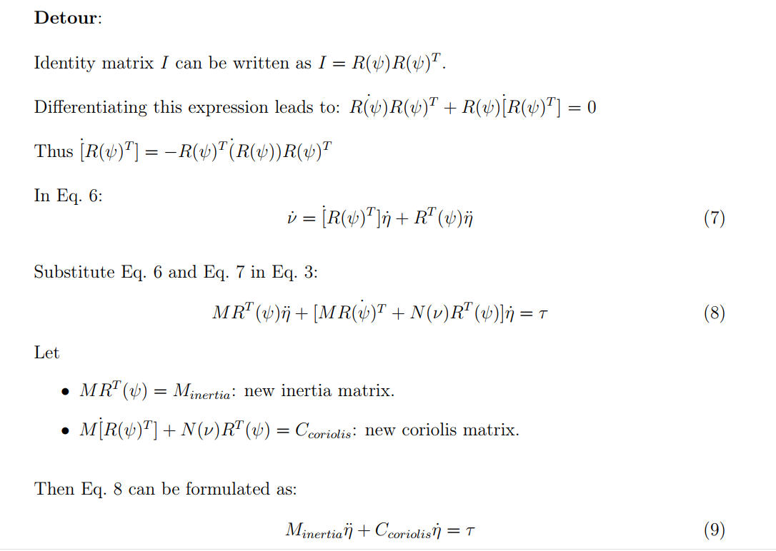
Boat Dynamic Model

Slide 9
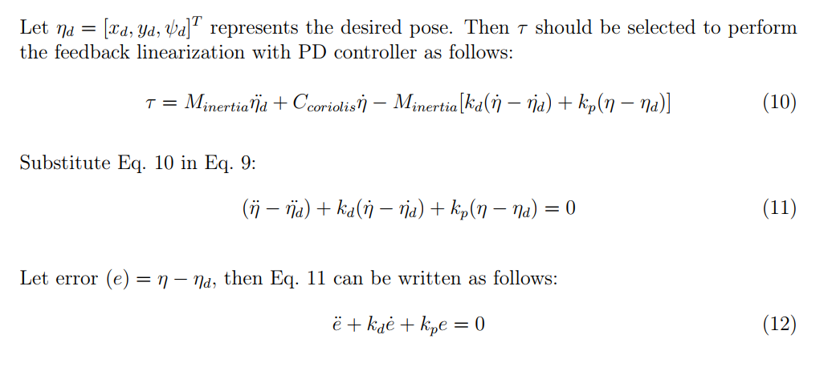
Feedback Linearization- PD control

Slide 10
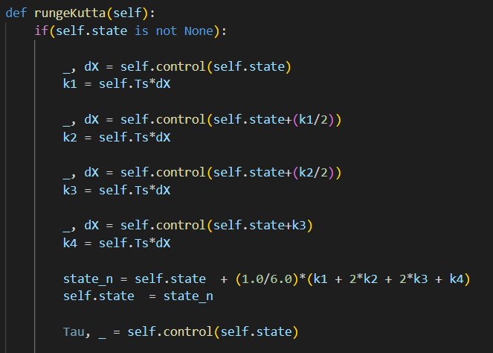
Odeint/RK4

Slide 11
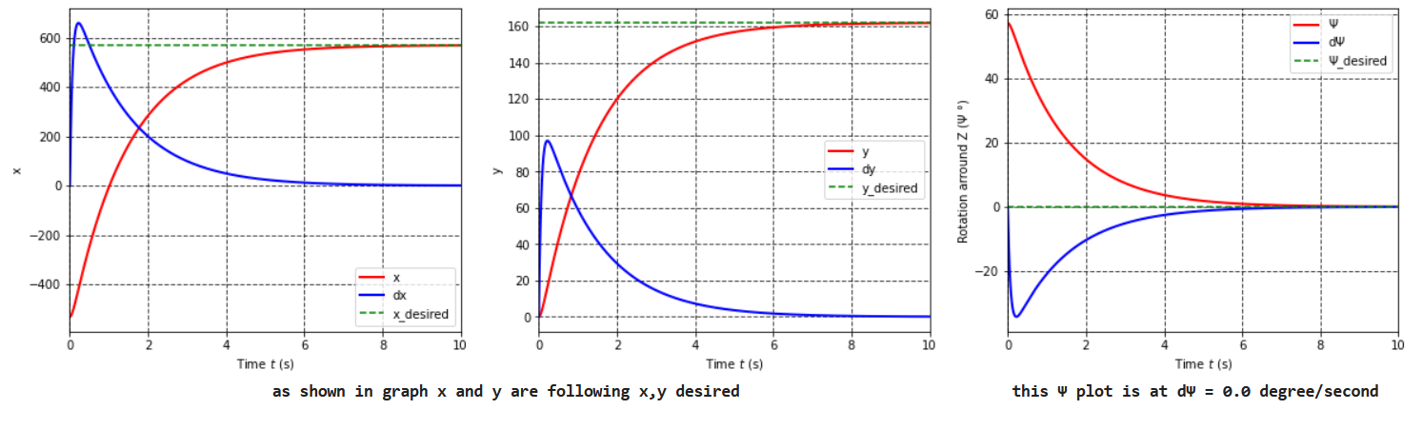
Odeint/RK4
Regulation

Slide 12
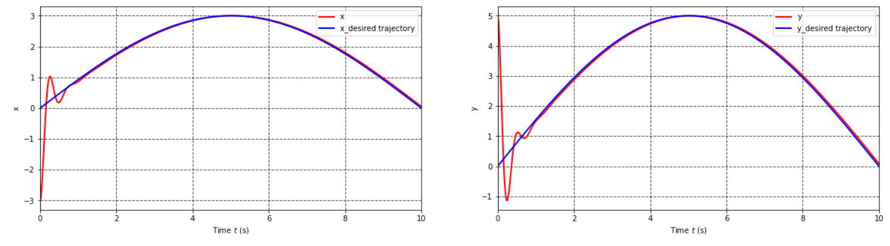
Odeint/RK4
Tracking
Notebook

Slide 13
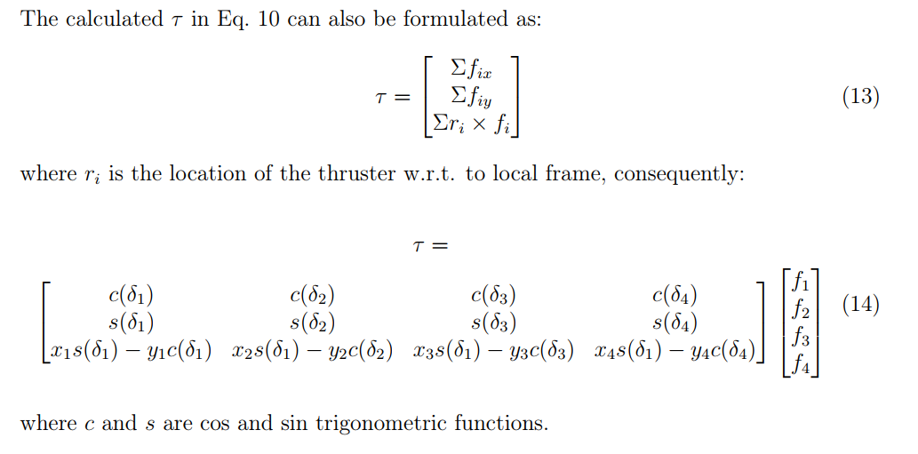
Thrust forces – Rudder Angles

Slide 14
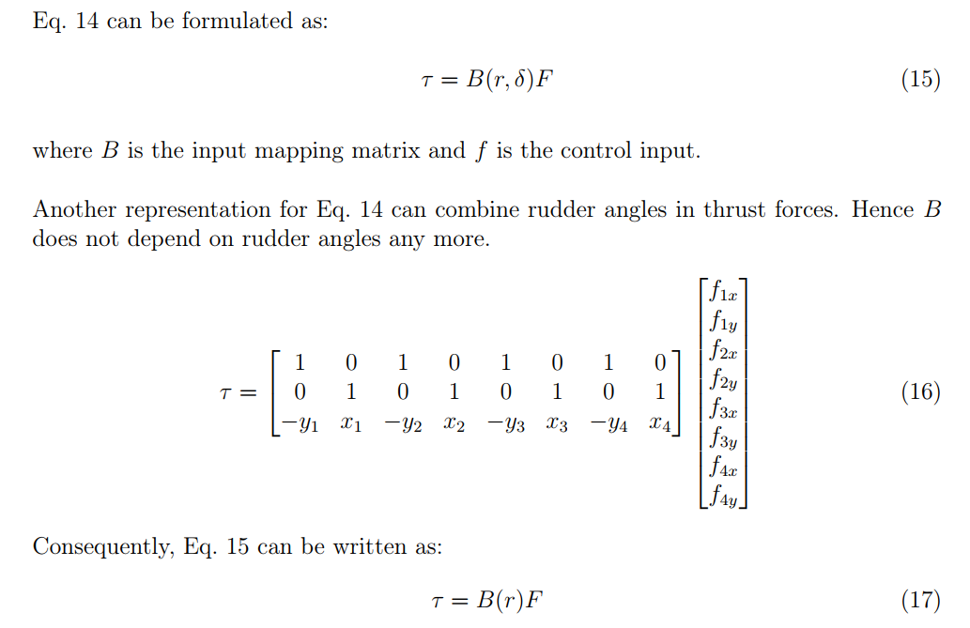
Thrust forces – Rudder Angles

Slide 15
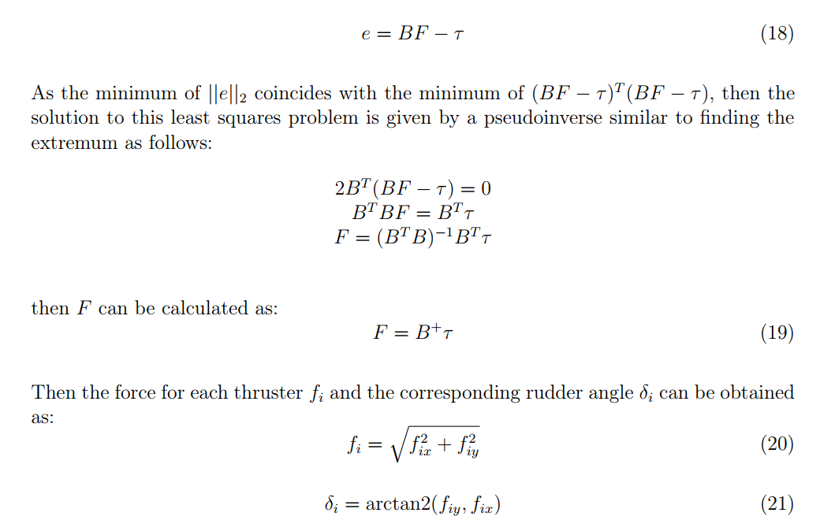
Thrust forces – Rudder Angles

Slide 16
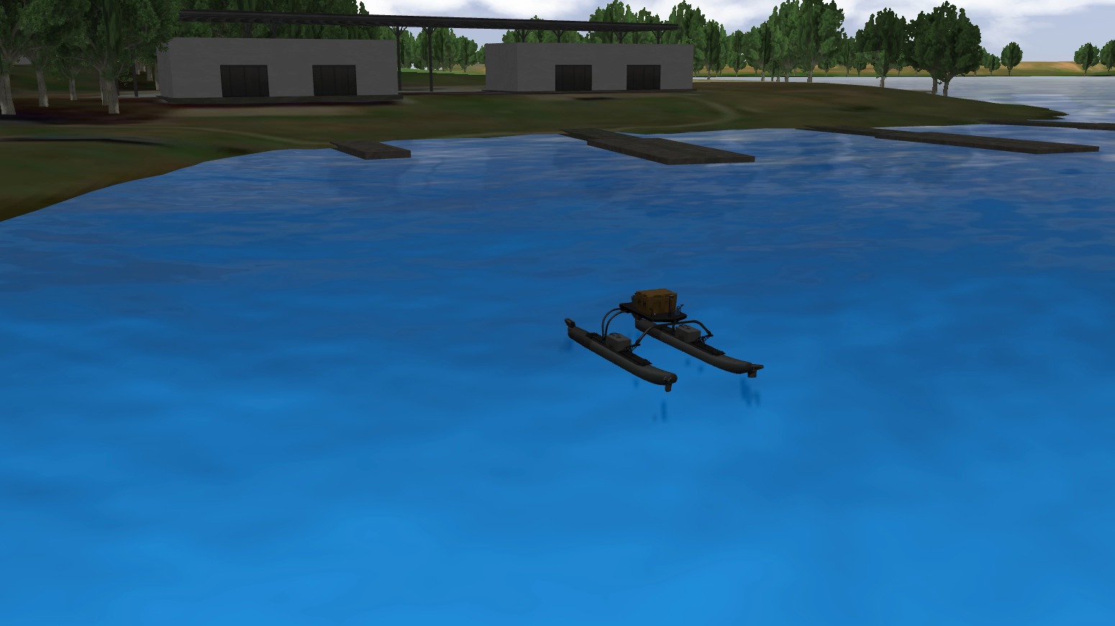
ROS2- Gazebo

Slide 17
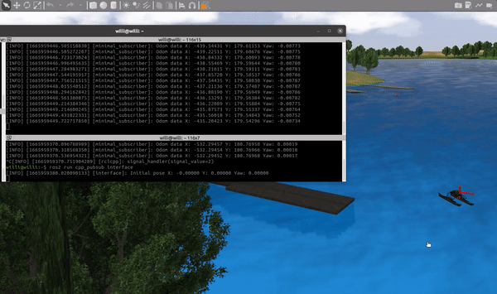
ROS2- Gazebo

Slide 18
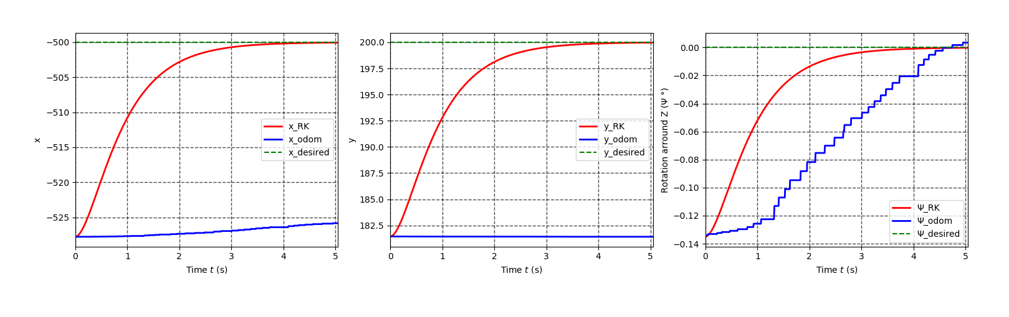
ROS2- Gazebo
Parameters estimation

Slide 19
References

Slide 20
Thank You !

